Slide 1
Python Course for Physicists (And everyone else!) Chunk 5: Loops
By Jonathan Bollig
08.10.2025

Slide 2
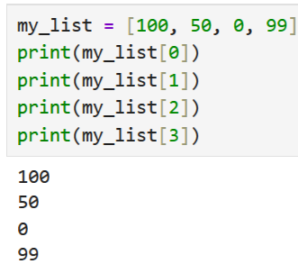
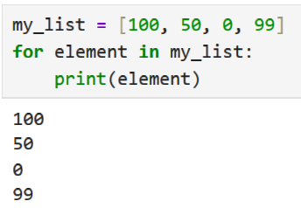
Loops: The Idea
Problem without loops: Print every element in a list individually.
Easier way: for – loops: Iterate through “iteratable” object: Lists and Set (later more)
Syntax:
Code
Generate Iteratable
Take first / next element of iteratable
Do something with element
Continue with Code

Slide 3
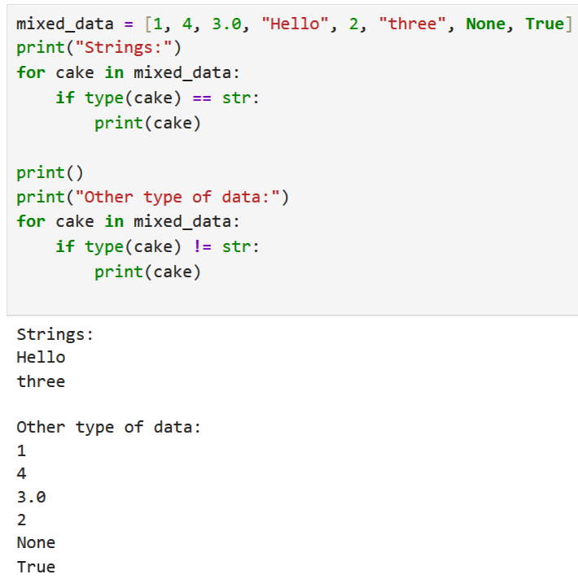
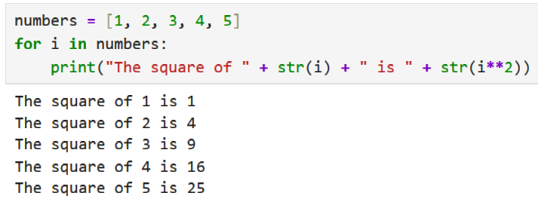
Live Coding: Loop examples
Squaring numbers:
Filtering strings:

Slide 4
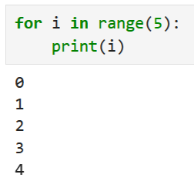
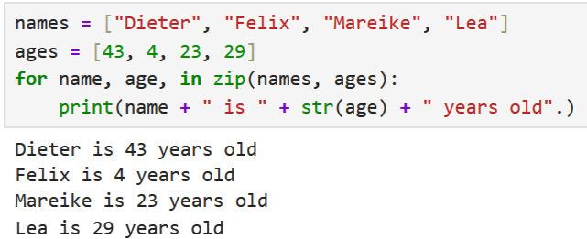
Live coding: range and zip
Range: Iteratable that counts: range(n) ≙ [0, 1, 2, 3, …, n-1]
zip: iterate multiple iterators:
for i, j in zip(list1, list2):

Slide 5
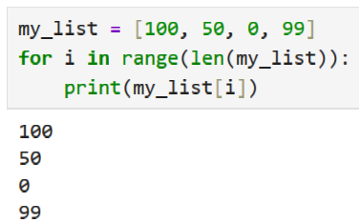
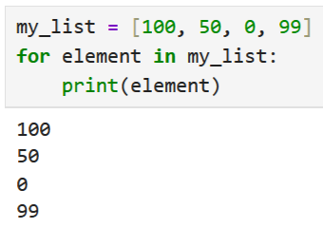
Caveat: C / Java Style Loops
Don’t use C / Java style loops !!!!!
☹
☺

Slide 6
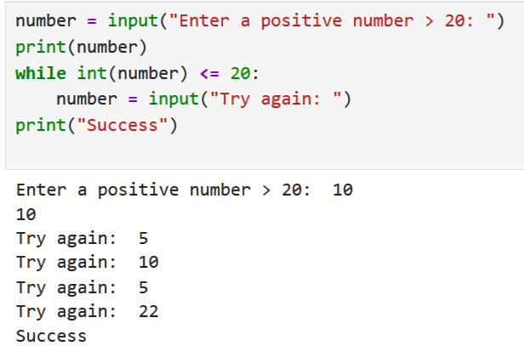
while - loops
Used, when the number of itarations is unknown → not so often in scientific programming.
Code
Check if Condition is met
Execute Code
True
False
Continue with Code

Slide 7
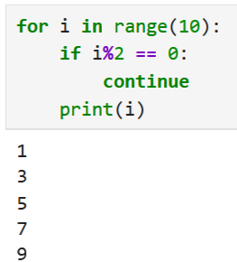
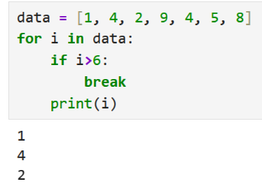
break & continue
Rarely used in scientific computing.
continue ≙ skip current iteration:
break ≙ exit loop:

Slide 8
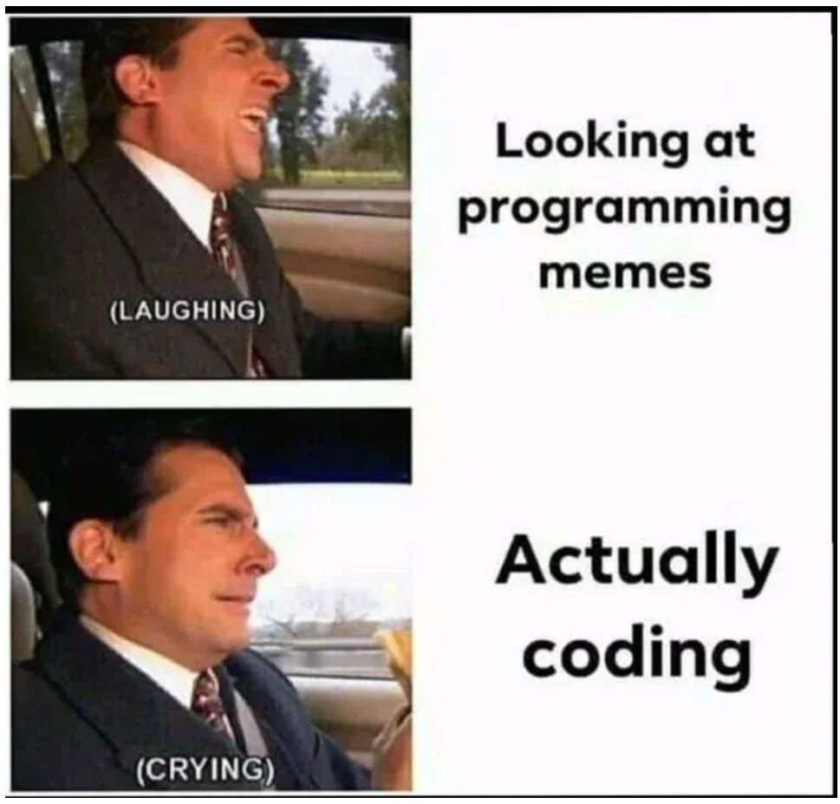
Good Luck with your Tasks ☺
[https://medium.com/codex/10-best-programming-memes-1-cec344afc19a]

